Slide 1
Clustering Algorithms
BRICH
Affinity Propagation
Mean Shift
DBSCAN
HDBSCAN
OPTICS
Spectral Clustering

Slide 2
BIRCH
BIRCH (Balanced Iterative Reducing and Clustering using Hierarchies) is a hierarchical clustering algorithm designed for handling large datasets efficiently. It operates in multiple phases to achieve this

Slide 3
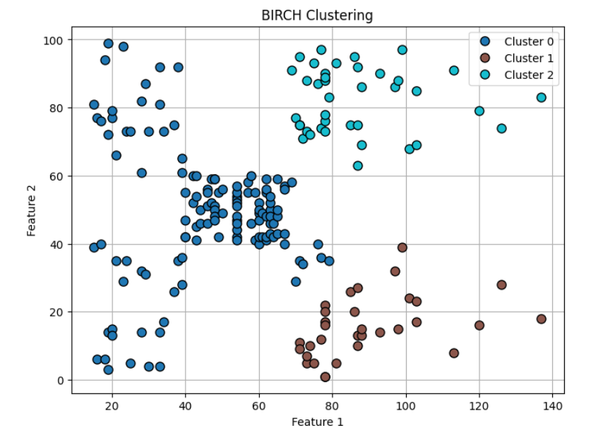
BIRCH
BIRCH (Balanced Iterative Reducing and Clustering using Hierarchies) is a hierarchical clustering algorithm designed for handling large datasets efficiently. It operates in multiple phases to achieve this

Slide 4
BIRCH
A compact summary of a cluster, represented by a 3-dimensional vector: (N,LS,SS)open paren cap N comma cap L cap S comma cap S cap S close paren
(𝑁,𝐿𝑆,𝑆𝑆), where:
Ncap N
𝑁 -is the number of data points in the cluster.
LScap L cap S
𝐿𝑆 - is the linear sum of the data points.
SScap S cap S
𝑆𝑆 - is the squared sum of the data points.
These values allow for the calculation of cluster properties like centroid, radius, and diameter without storing all individual data points.

Slide 5
BIRCH
Building the CF Tree:
The algorithm scans the dataset once.
For each data point, it traverses the CF tree from the root to find the closest leaf node (sub-cluster) to which the data point can be assigned without violating a specified threshold (e.g., maximum radius or diameter of a sub-cluster).
If the data point can be added to an existing leaf node, the CF of that node and its ancestors are updated.
If adding the data point would violate the threshold, a new leaf node is created. If the parent node is full, it may split, leading to potential splits up the tree.
Global Clustering (Optional):
After the CF tree is built, the CFs in the leaf nodes can be treated as a smaller, summarized dataset.
A traditional clustering algorithm (e.g., agglomerative hierarchical clustering or K-Means) can then be applied to these CFs to obtain the final clusters. This step refines the initial micro-clusters formed in the CF tree.

Slide 6
BIRCH
Advantages:
Efficiency: Handles large datasets with a single scan, making it memory-efficient and scalable.
Speed: Has a time complexity of O(N), where N is the number of data points, making it significantly faster than some other hierarchical clustering methods for large datasets.
Incremental: Can process data incrementally as it arrives.
Limitations:
Numerical Data Only: Primarily designed for numerical data and cannot directly handle categorical features.
Sensitivity to Order: Can be sensitive to the order in which data points are inserted, potentially leading to slightly different CF trees and final clusters.
Curse of Dimensionality: Performance can degrade in very high-dimensional spaces.

Slide 7
Affinity Propagation
It creates clusters by sending messages between pairs of samples until convergence. A dataset is then described using a small number of exemplars, which are identified as those most representative of other samples. The messages sent between pairs represent the suitability for one sample to be the exemplar of the other, which is updated in response to the values from other pairs. This updating happens iteratively until convergence, at which point the final exemplars are chosen.

Slide 8
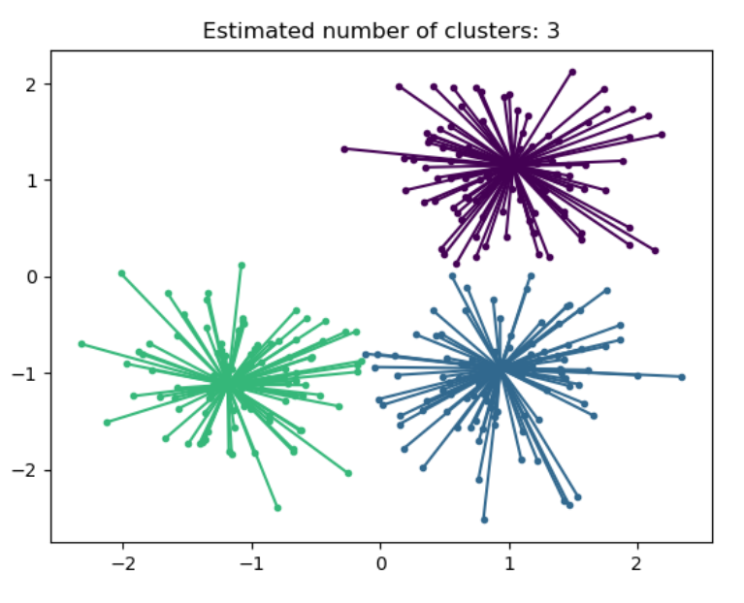
Image

Slide 9
Affinity Propagation
Advantages:
No need to specify number of clusters
Can find clusters of different sizes and densities
Uses actual data points as exemplars
Limitations:
Computationally expensive: O(N2T)O(N^2T)O(N2T) where NNN is number of points and TTT is number of iterations
Needs careful tuning of preference values
Not scalable for very large datasets
Applications:
Image segmentation
Document clustering
Bioinformatics (e.g., gene expression data)

Slide 10
Affinity Propagation
Advantages:
Efficiency: Handles large datasets with a single scan, making it memory-efficient and scalable.
Speed: Has a time complexity of O(N), where N is the number of data points, making it significantly faster than some other hierarchical clustering methods for large datasets.
Incremental: Can process data incrementally as it arrives.
Limitations:
Numerical Data Only: Primarily designed for numerical data and cannot directly handle categorical features.
Sensitivity to Order: Can be sensitive to the order in which data points are inserted, potentially leading to slightly different CF trees and final clusters.
Curse of Dimensionality: Performance can degrade in very high-dimensional spaces.

Slide 11
Mean Shift
Mean Shift clustering aims to discover blobs in a smooth density of samples. It is a centroid based algorithm, which works by updating candidates for centroids to be the mean of the points within a given region. These candidates are then filtered in a post-processing stage to eliminate near-duplicates to form the final set of centroids.

Slide 12
Mean Shift
Key Concepts:
Kernel Density Estimation (KDE):
Mean Shift works by estimating the density of data points using a kernel function (typically a Gaussian).
It shifts each data point toward regions with higher data density (i.e., local maxima of the density function).
Bandwidth (Kernel Size):
Critical parameter that controls the window size used for density estimation.
A larger bandwidth results in fewer clusters; smaller bandwidth gives more clusters.
Often determined using methods like scikit-learn’s estimate_bandwidth.
Algorithm Steps:
For each data point, place a window (kernel) around it.
Compute the mean of points within the window.
Shift the center of the window to this mean.
Repeat until convergence (the shift becomes small).
After convergence, points that converge to the same mean are assigned to the same cluster.

Slide 13
Mean Shift
Strengths:
No need to specify number of clusters.
Can find arbitrarily shaped clusters.
Works well with non-linearly separable data.
Clusters align with modes of data distribution.
Limitations:
Computationally expensive, especially in high dimensions (complexity: O(N2)O(N^2)O(N2))
Performance and results sensitive to bandwidth selection.
May struggle with varying densities in the data.
Applications:
Image processing (e.g., segmentation)
Object tracking
Computer vision tasks
Clustering GPS coordinates or spatial data

Slide 14
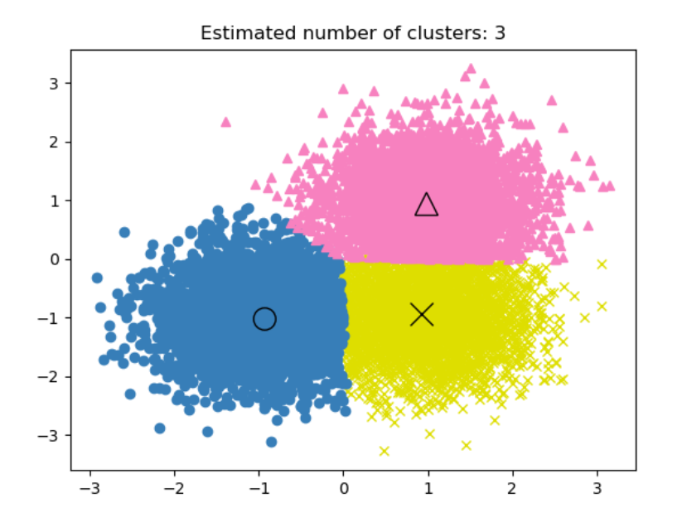
Mean Shift

Slide 15
DBSCAN
DBSCAN algorithm views clusters as areas of high density separated by areas of low density. Due to this rather generic view, clusters found by DBSCAN can be any shape, as opposed to k-means which assumes that clusters are convex shaped. The central component to the DBSCAN is the concept of core samples, which are samples that are in areas of high density.

Slide 16
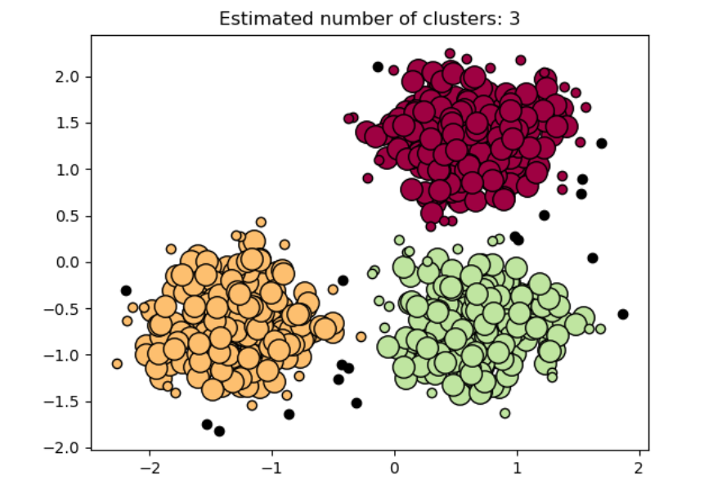
DBSCAN

Slide 17
DBSCAN
Parameters:
ε (Epsilon): The radius around a point to consider neighbors (neighborhood distance).
MinPts: Minimum number of points required to form a dense region (core point).
🔄 Core Concepts:
Core Point: A point with at least MinPts neighbors within distance ε.
Border Point: A point that is within ε distance of a core point but has fewer than MinPts neighbors.
Noise Point: A point that is neither a core point nor a border point.
🔁 Algorithm Steps:
For each point, find points within ε radius (neighbors).
If a point has ≥ MinPts neighbors, it’s a core point and starts a new cluster.
Expand the cluster by recursively including all points density-reachable from core points.
Border points get assigned to the nearest cluster.
Points that are not assigned to any cluster are labeled as noise.

Slide 18
DBSCAN
Advantages:
Can find clusters of arbitrary shape (unlike k-means).
Automatically detects noise/outliers.
Does not require specifying the number of clusters.
Works well when clusters are dense and separated by sparse regions.
Limitations:
Sensitive to the choice of ε and MinPts.
Struggles with datasets of varying density.
Not very efficient for very high-dimensional data.
Computational complexity roughly O(nlog⁡n)O(n \log n)O(nlogn) with spatial indexing; otherwise O(n2)O(n^2)O(n2).
Applications:
Spatial data analysis (e.g., geographic data)
Anomaly detection
Image segmentation
Market segmentation

Slide 19
HDBSCAN
HDBSCAN is an improved, hierarchical extension of DBSCAN that can handle variable density clusters and automatically select the number of clusters. It combines density-based clustering with hierarchical clustering

Slide 20
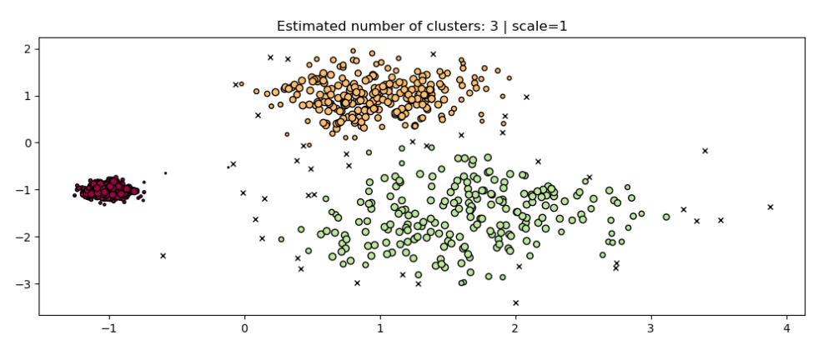
Image

Slide 21
HDBSCAN
Core Ideas:
Builds a hierarchy of clusters by varying the density level.
Uses mutual reachability distance to create a minimum spanning tree (MST) of the data points.
Extracts stable clusters from the hierarchy based on cluster persistence.
Can identify noise (outliers) naturally.
No need to specify ε explicitly (unlike DBSCAN).
Main Parameters:
min_cluster_size: Minimum size for a cluster to be considered valid.
min_samples: Controls how conservative the clustering is regarding noise (similar to MinPts in DBSCAN).
(Optional) cluster_selection_epsilon: A threshold to cut the hierarchy for flat clustering.
How HDBSCAN Works:
Calculate mutual reachability distances between points to create a weighted graph.
Build a minimum spanning tree (MST) of the graph.
Construct a cluster hierarchy by progressively removing edges from the MST based on distance.
Use a condensed cluster tree to extract clusters by selecting the most stable clusters (those persisting over wide density ranges).
Label points not assigned to any cluster as noise.

Slide 22
HDBSCAN
Advantages:
Handles clusters of varying densities well.
Detects noise and outliers effectively.
Does not require specifying ε.
Automatically estimates the number of clusters.
Produces a hierarchical clustering, useful for understanding cluster structure.
Robust and effective in many practical scenarios.
Limitations:
More computationally intensive than DBSCAN.
Requires tuning of min_cluster_size (though often intuitive).
Slightly more complex to understand compared to DBSCAN or k-means.
Applications:
Anomaly detection
Complex data clustering with varying densities
Biological data (e.g., single-cell RNA-seq clustering)
Geospatial clustering with heterogeneous density

Slide 23
Spectral Clustering
Spectral clustering performs a low-dimension embedding of the affinity matrix between samples, followed by clustering, e.g., by KMeans, of the components of the eigenvectors in the low dimensional space.
Spectral Clustering is a powerful algorithm that uses graph theory and linear algebra to cluster data based on the eigenvalues (spectrum) of a similarity matrix. It is especially effective at identifying non-convex and complex-shaped clusters.

Slide 24
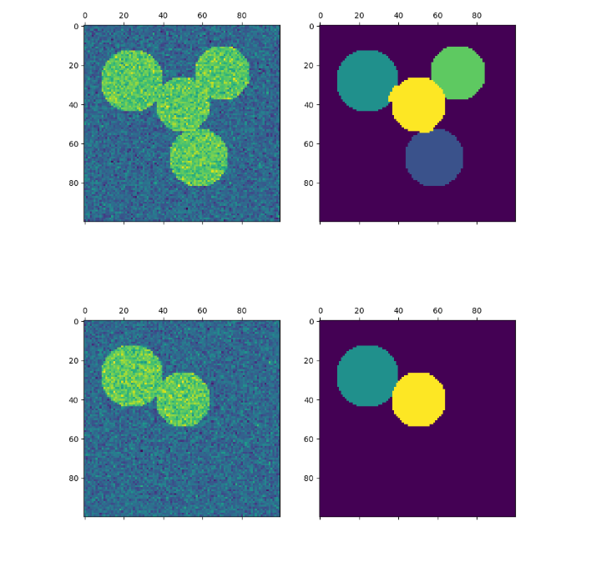
Spectral Clustering

Slide 25
Spectral Clustering
Core Idea:
Instead of clustering directly in the input space, Spectral Clustering:
Builds a similarity graph from the data.
Computes the graph Laplacian.
Uses its eigenvectors to embed the data into a lower-dimensional space.
Applies a standard clustering algorithm (usually k-means) in this new space.
🔁 Algorithm Steps:
Construct a Similarity Graph:
Each node is a data point.
Edges represent similarity (e.g., Gaussian kernel:
s(x_i, x_j) = \exp\left(-\frac{\|x_i - x_j\|^2}{2\sigma^2}\right) \])
Compute the Laplacian Matrix:
Options:
Unnormalized: L=D−WL = D - WL=D−W
Normalized: Lsym=D−1/2LD−1/2L_{\text{sym}} = D^{-1/2}LD^{-1/2}Lsym​=D−1/2LD−1/2
Where:
WWW = similarity matrix
DDD = degree matrix (diagonal matrix where Dii=∑jWijD_{ii} = \sum_j W_{ij}Dii​=∑j​Wij​)
Compute Eigenvectors:
Select the first k eigenvectors of the Laplacian (corresponding to smallest eigenvalues).
These form a new feature space.
Cluster:
Apply k-means to the rows of the matrix formed by the k eigenvectors.

Slide 26
Spectral Clustering
Advantages:
Can identify non-linearly separable clusters.
Works well for complex shapes, e.g., concentric circles or moons.
Flexible: works on arbitrary similarity graphs.
Limitations:
Requires specifying the number of clusters k.
Computationally expensive for large datasets (due to eigen-decomposition).
Sensitive to the choice of similarity function and parameters (e.g., kernel width σ\sigmaσ).
Applications:
Image segmentation
Community detection in networks
Natural language processing (e.g., document clustering)
Shape recognition

Slide 27
OPTICS (Ordering Points To Identify the Clustering Structure)
OPTICS is a density-based clustering algorithm, similar to DBSCAN, but more powerful. It is designed to discover clusters of varying densities without requiring a single global density threshold like DBSCAN does.
Goal: Generate an augmented ordering of the data points to extract clusters of varying densities, and to visualize the cluster structure (reachability plot).

Slide 28
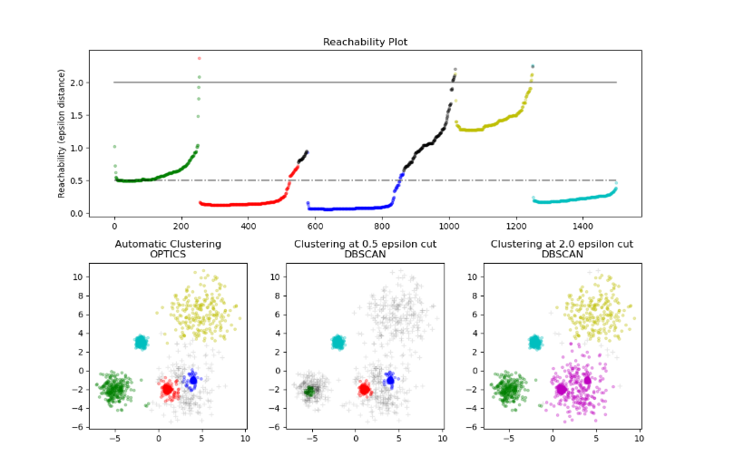
OPTICS Clustering

Slide 29
OPTICS Clustering
Key Concepts:
ε (Epsilon): Maximum radius to consider neighbors (used as an upper bound, not a hard cutoff like in DBSCAN).
minPts: Minimum number of neighbors to define a core point.
Core Distance: For a point, the distance to its minPts-th nearest neighbor. If not enough neighbors, undefined.
Reachability Distance: For point ppp with respect to core point ooo:
reachability_dist(p,o)=max⁡(core_dist(o),dist(p,o))\text{reachability\_dist}(p, o) = \max(\text{core\_dist}(o), \text{dist}(p, o))reachability_dist(p,o)=max(core_dist(o),dist(p,o)) Measures how easily ppp can be reached from ooo.
How OPTICS Works:
Initialize all points as unprocessed.
For each unprocessed point:
Compute core distance.
Use it to compute reachability distances of neighbors.
Place points into an ordered list based on reachability.
After all points are ordered, generate a reachability plot.
Clusters can be extracted visually or algorithmically from the plot.
Reachability Plot:
A valley in the plot indicates a dense cluster.
Peaks represent sparse regions or cluster boundaries.
The height reflects reachability distance (density).

Slide 30
OPTICS Clustering
Advantages:
Handles clusters of varying density (unlike DBSCAN).
Automatically detects cluster structure.
Identifies noise and outliers.
Does not require a fixed epsilon for clustering.
Limitations:
Requires tuning of minPts (and optionally ε, though not critical).
Computationally expensive for large datasets.
Reachability plot interpretation can be subjective without automatic extraction.
Applications:
Geospatial data clustering
Customer segmentation
Anomaly detection
Any use case where density varies across clusters

Slide 31
Comparison
Algorithm | Type | Assumptions | Pros | Cons | Suitable For
K-Means | Centroid-based | Spherical clusters of equal size | Simple, fast, scalable | Requires k, sensitive to outliers | Large datasets, well-separated data
Hierarchical | Connectivity-based | Hierarchical structure | No need to specify k, dendrogram | Not scalable for large datasets | Small datasets, visual exploration
DBSCAN | Density-based | Dense regions separated by sparse | Finds arbitrary-shaped clusters, outlier detection | Struggles with varying densities | Spatial data, noise-tolerant tasks
OPTICS | Density-based | Similar to DBSCAN, but more flexible | Handles varying densities | Slower than DBSCAN | Complex density-based data
Mean Shift | Centroid-based | Data has dense areas | Does not require k, finds number of clusters automatically | Computationally expensive | Image processing, blob detection
Spectral Clustering | Graph-based | Uses graph theory & eigenvectors | Captures complex cluster shapes | Computationally expensive, not scalable | Non-convex clusters, small datasets
BIRCH | Hierarchical | Balanced trees | Scalable, good for large data | Performs poorly on non-globular clusters | Large datasets, incremental clustering
Agglomerative | Hierarchical | Clusters formed bottom-up | Easy to understand | High computational cost | Small, hierarchical datasets

Slide 32
Metrics
Metric | Description | Best Algorithms
Speed/Scalability | How fast the algorithm runs on large datasets | K-Means, BIRCH
Shape of Clusters | Can it detect non-spherical clusters? | DBSCAN, Spectral, GMM
Robustness to Noise | Can it handle outliers? | DBSCAN, OPTICS
Number of Clusters | Does it auto-determine the optimal number? | Mean Shift, DBSCAN, OPTICS
Interpretability | Ease of understanding and explaining results | K-Means, Hierarchical

Slide 33
Tips to choose a right Algorithm
Do I know how many clusters I want? → Try K-Means or GMM
Is my data noisy or contains outliers? → Try DBSCAN or OPTICS
Are my clusters irregularly shaped? → Try Spectral Clustering
Do I need soft clustering? → Try GMM
Is interpretability important? → Try Hierarchical Clustering
Am I working with a large dataset? → Try BIRCH, K-Means

Slide 34
THANK YOU !!

